Slide 1
SQL: DATA QUERY
By-Prashant Kumar Singh

Slide 2
Tables Used
DailyActivity
SleepData
HourlyActivity
HeartRateHourly

Slide 3
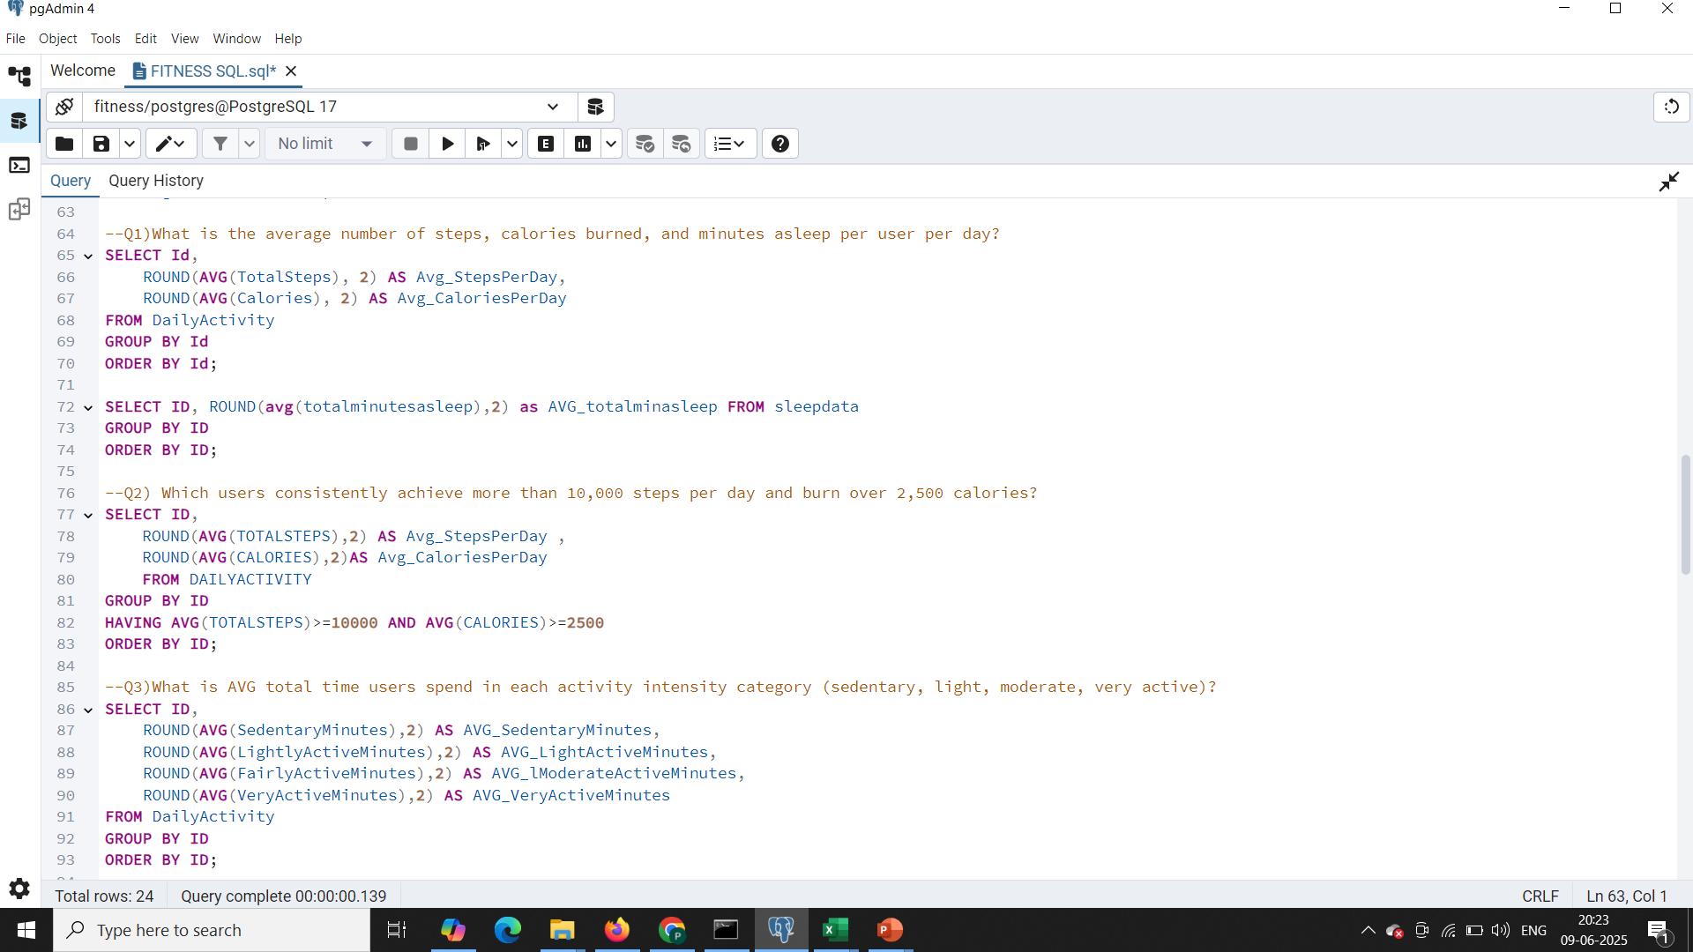
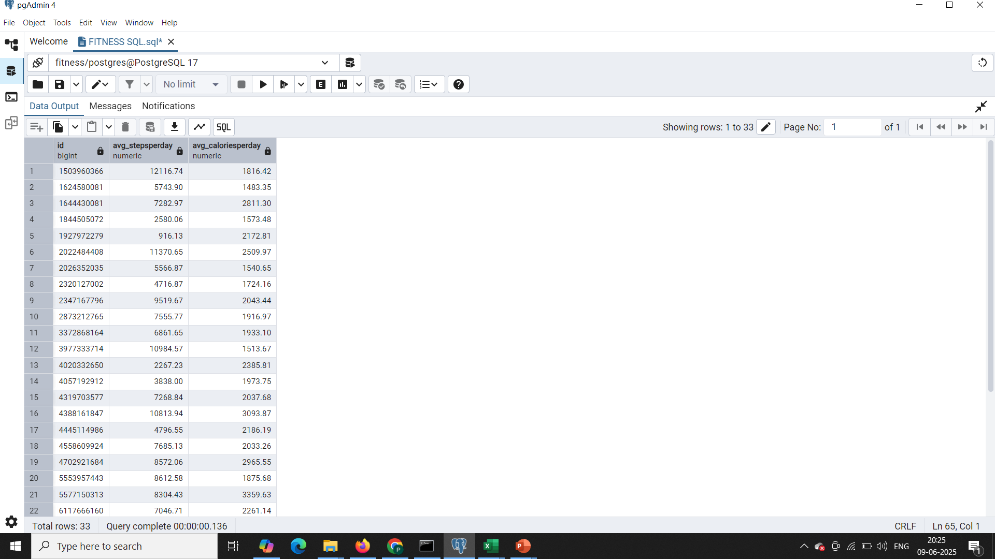

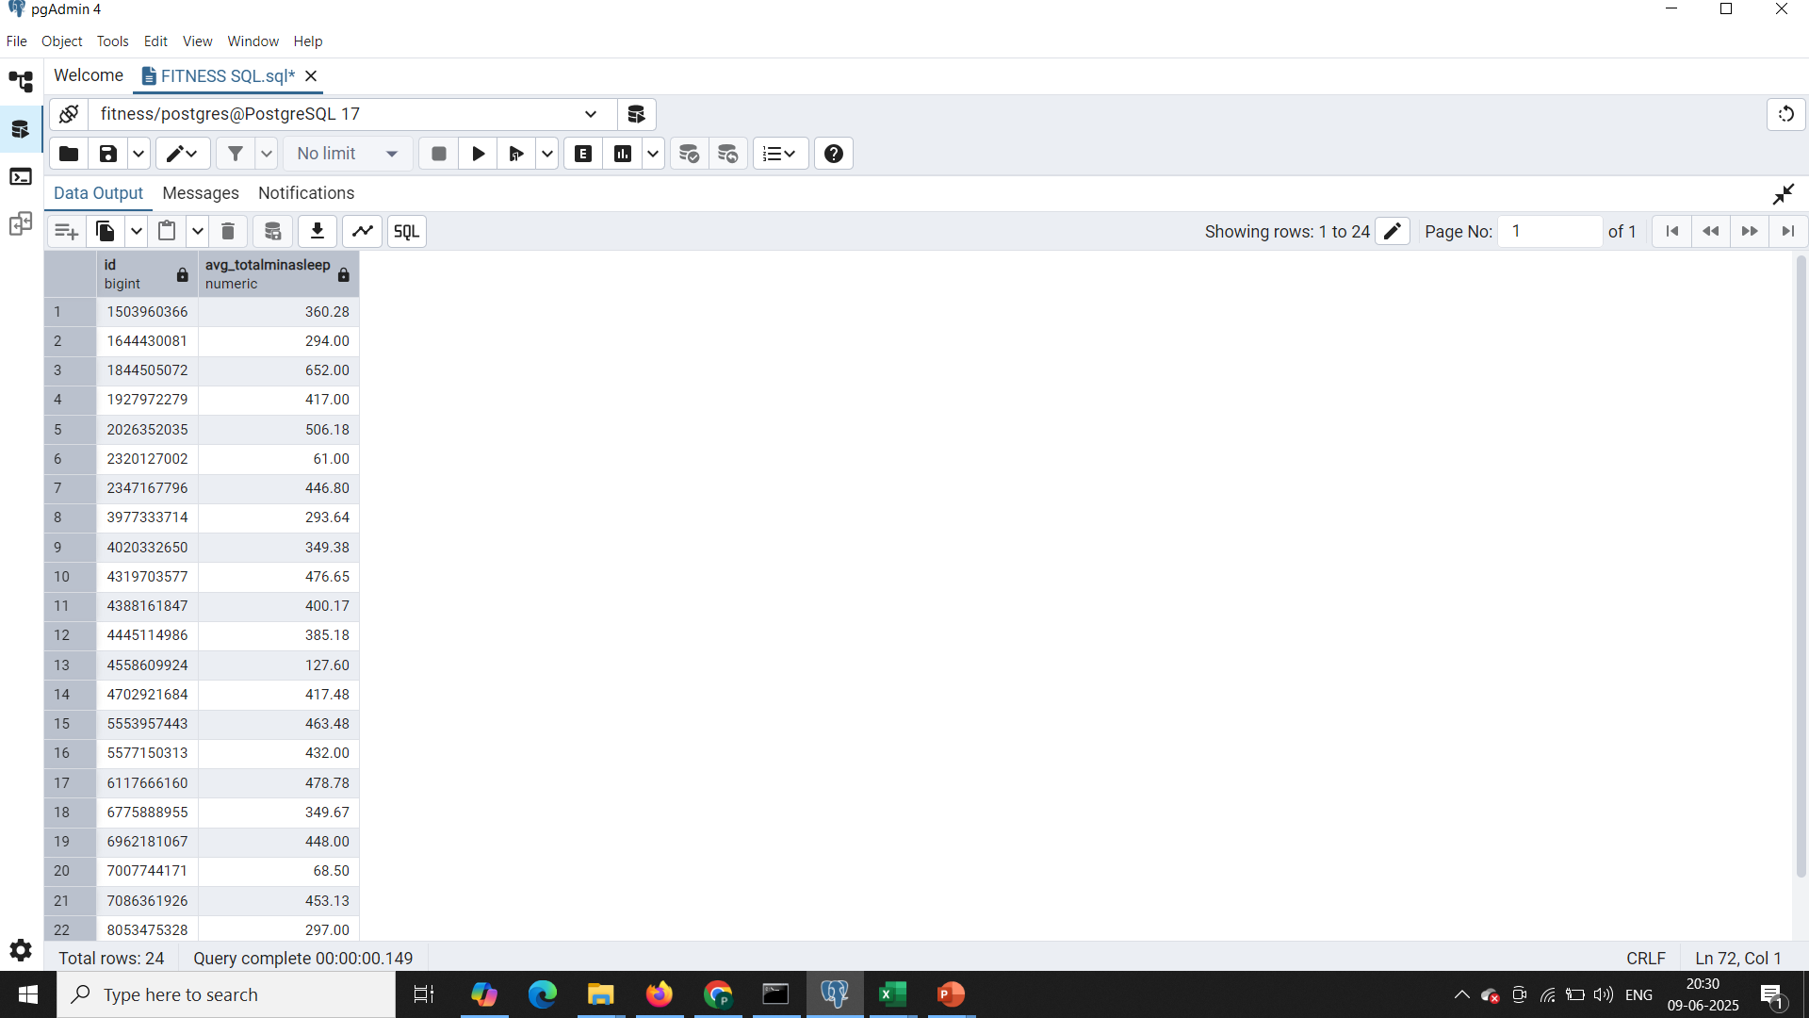

Q1)What is the average number of steps, calories burned, and minutes asleep per user per day?

Slide 4
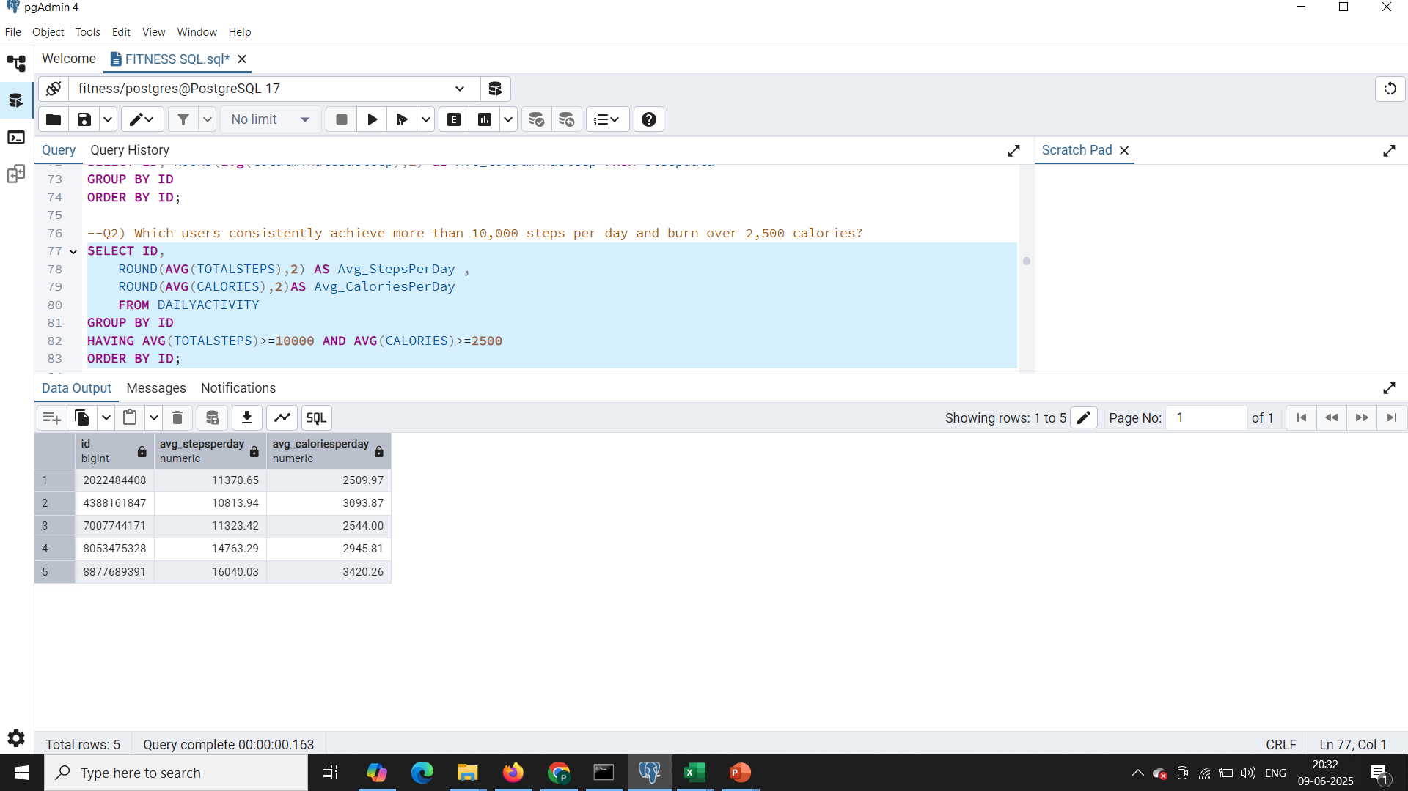
Q2) Which users consistently achieve more than 10,000 steps per day and burn over 2,500 calories?

Slide 5
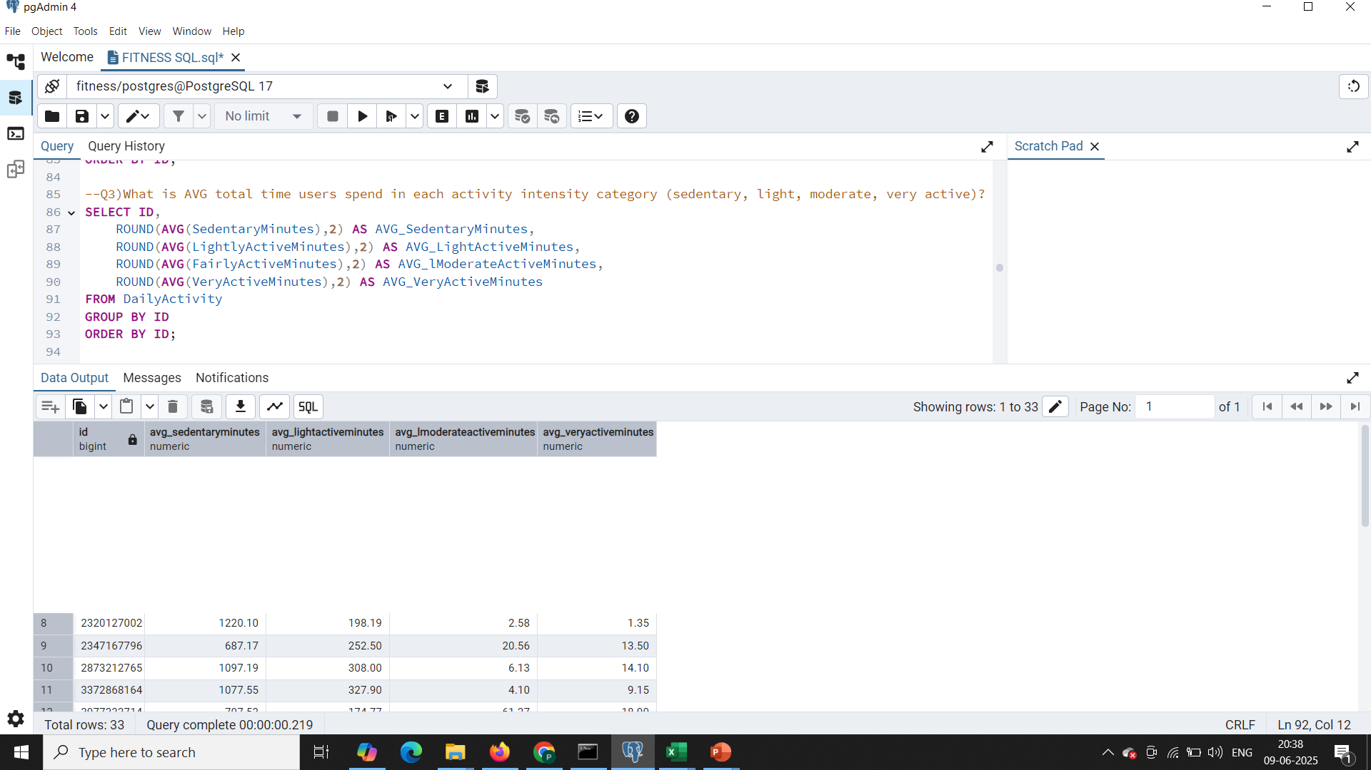
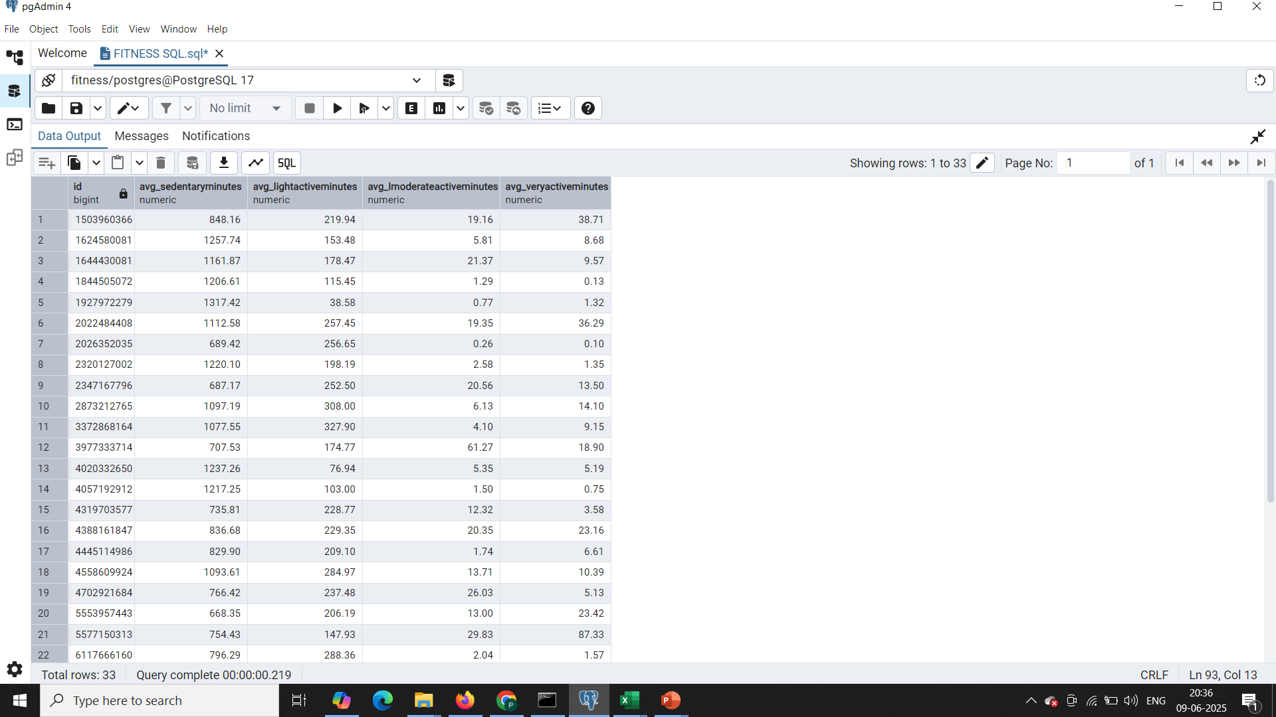
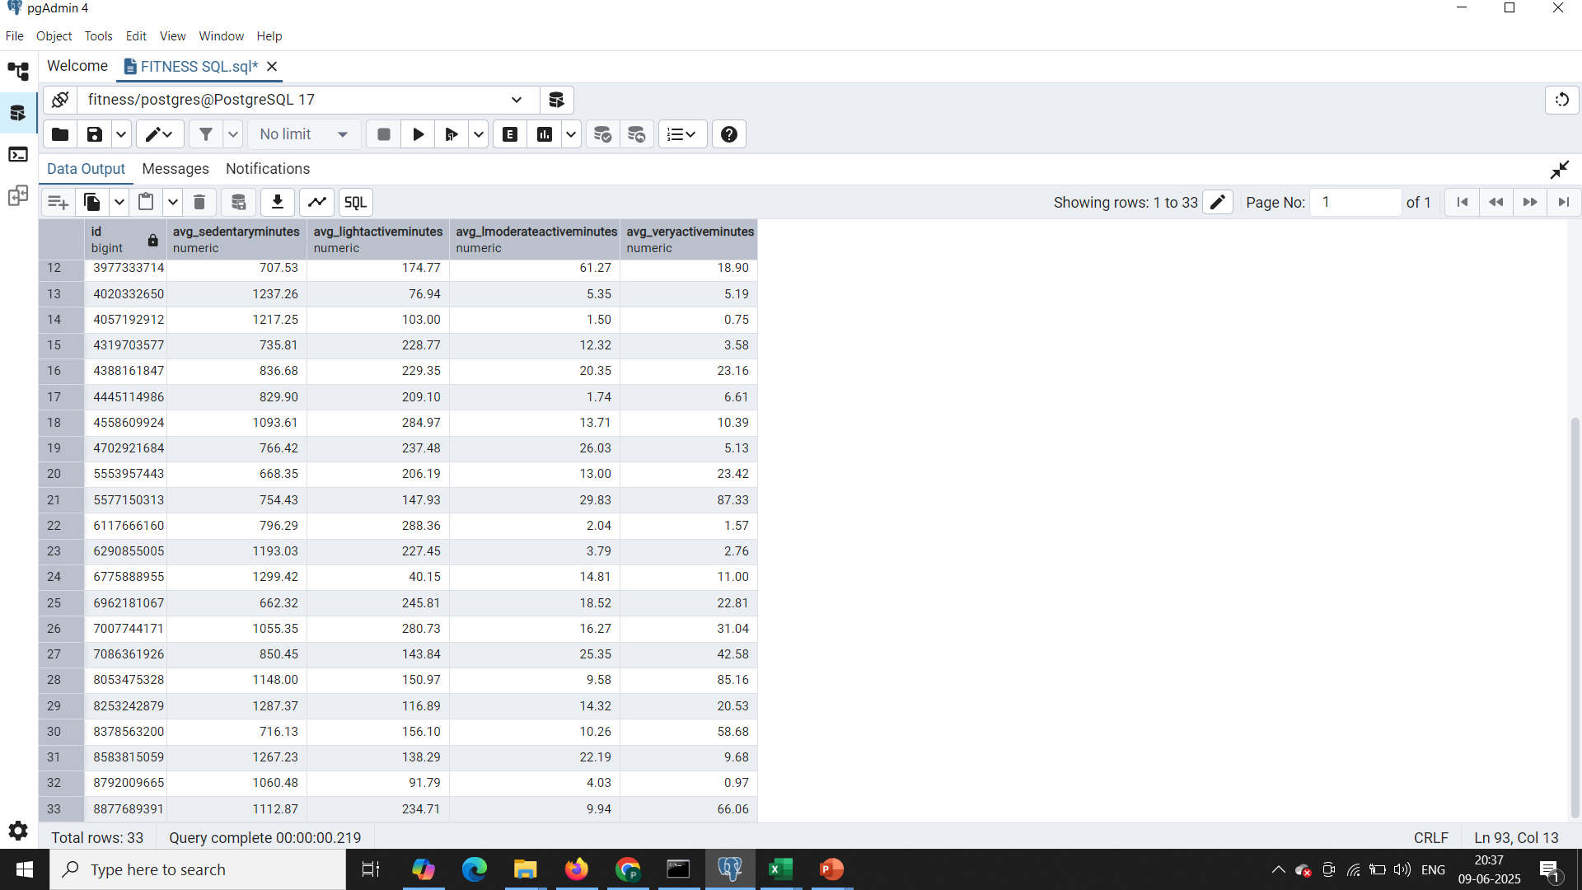
Q3.What is AVG total time users spend in each activity intensity category (sedentary, light, moderate, very active)?

Slide 6
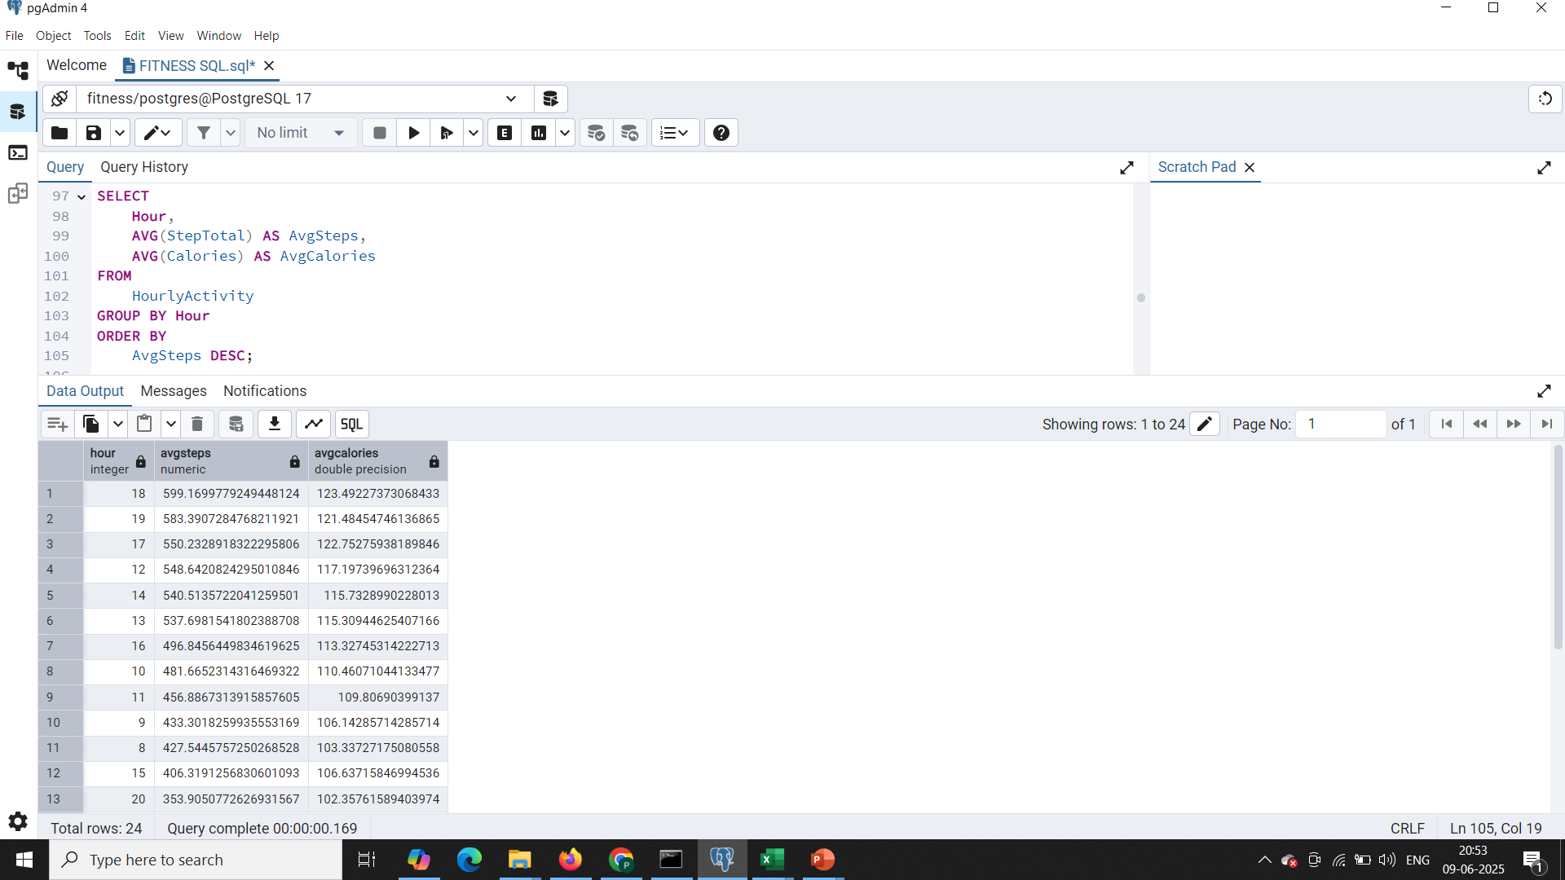
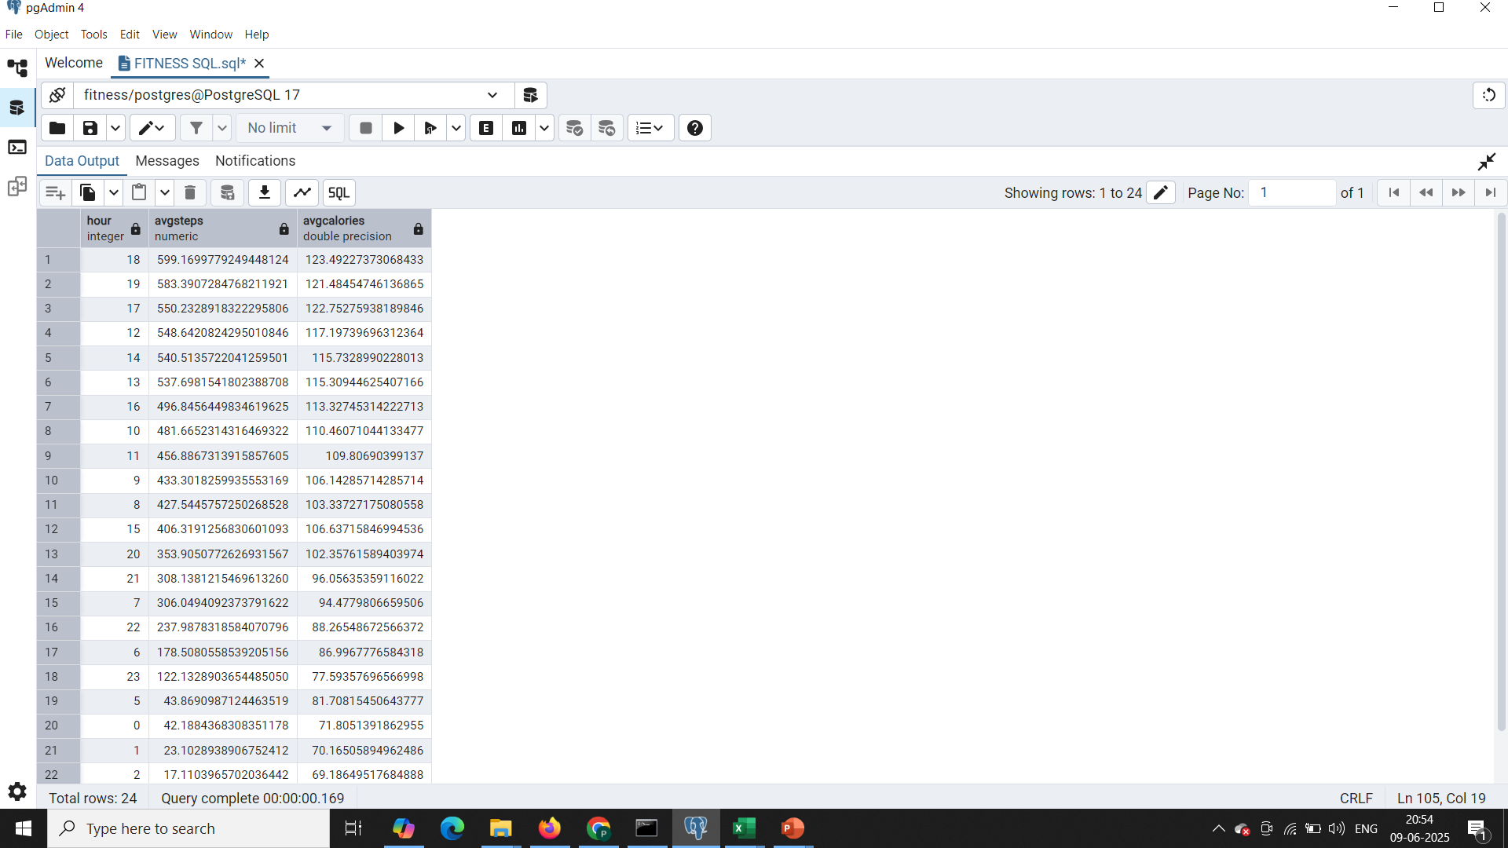

Q4. Which hours of the day have the highest average steps and calorie burn?

Slide 7
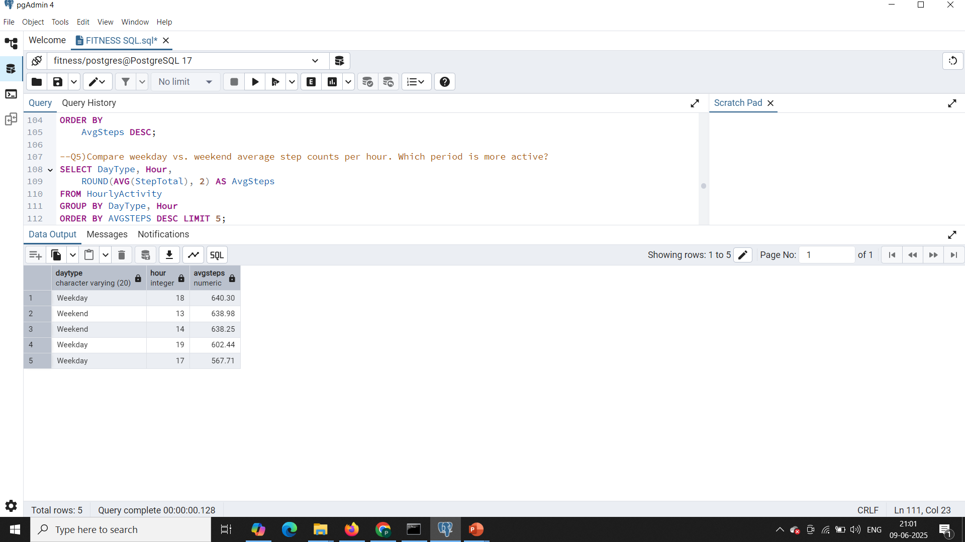
Q5. Compare weekday vs. weekend average step counts per hour. Which period is more active?

Slide 8
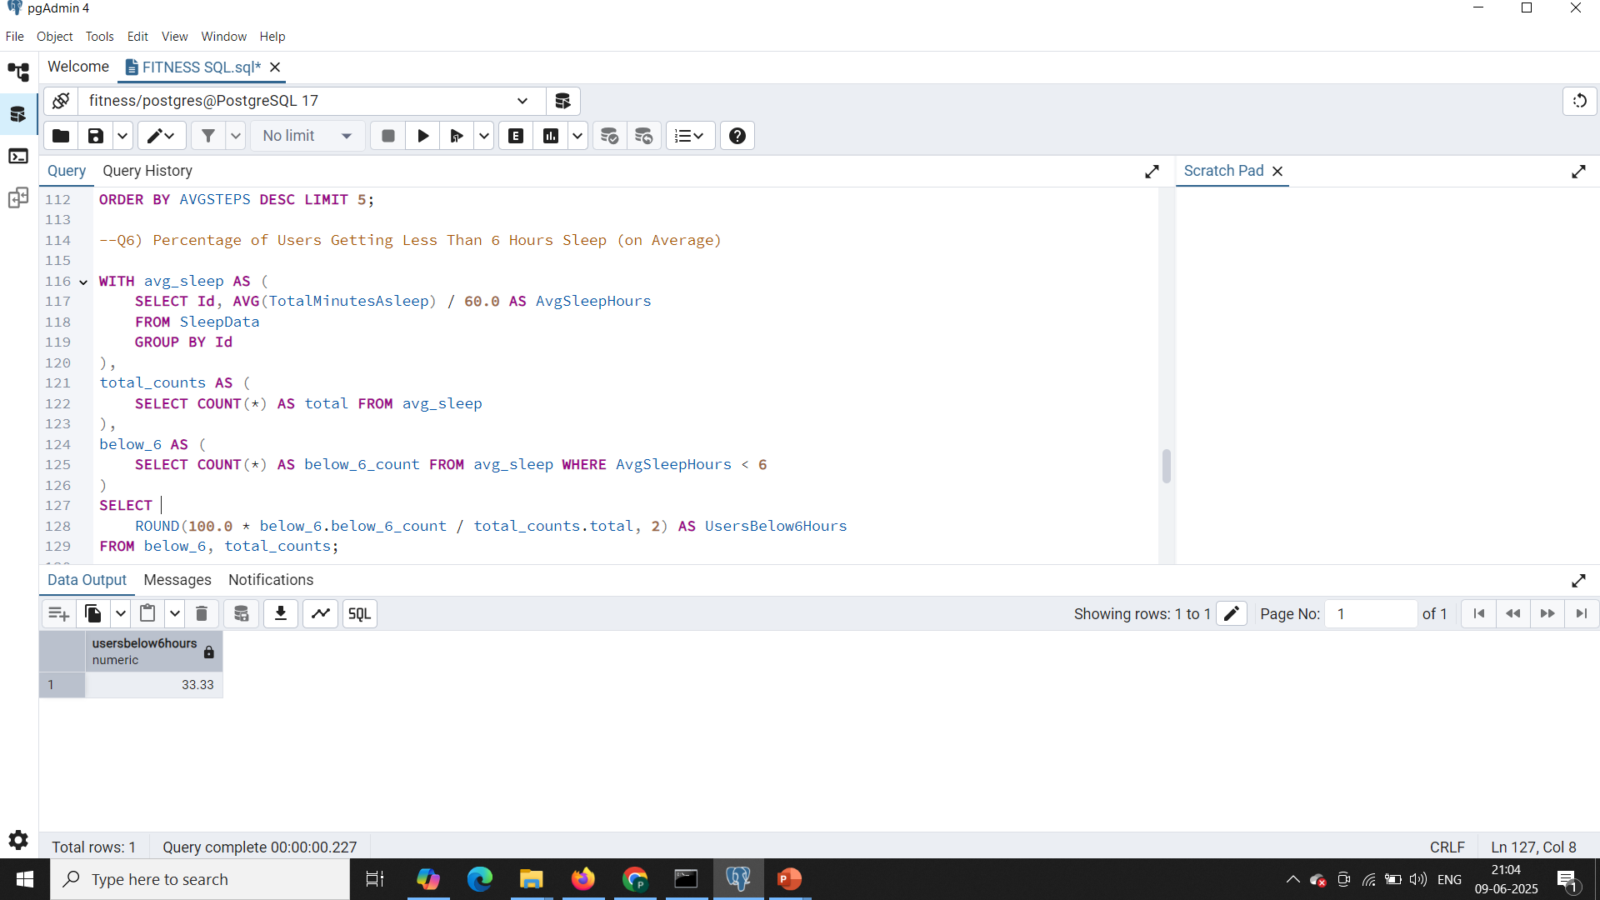
Q6. Percentage of Users Getting Less Than 6 Hours Sleep (on Average)

Slide 9
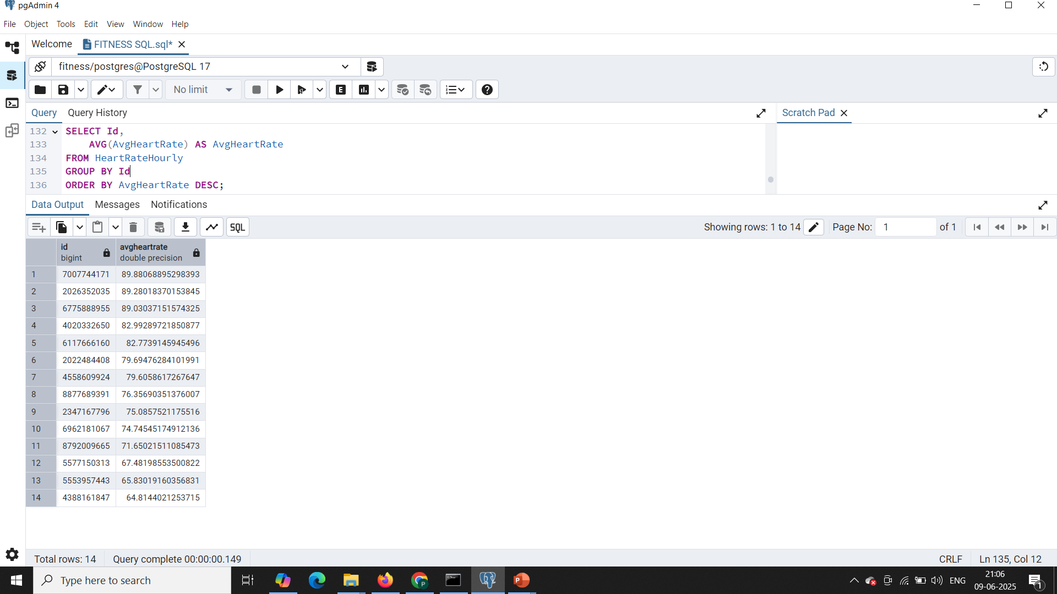
Q7. Which users have the highest and lowest average heart rates?

Slide 10
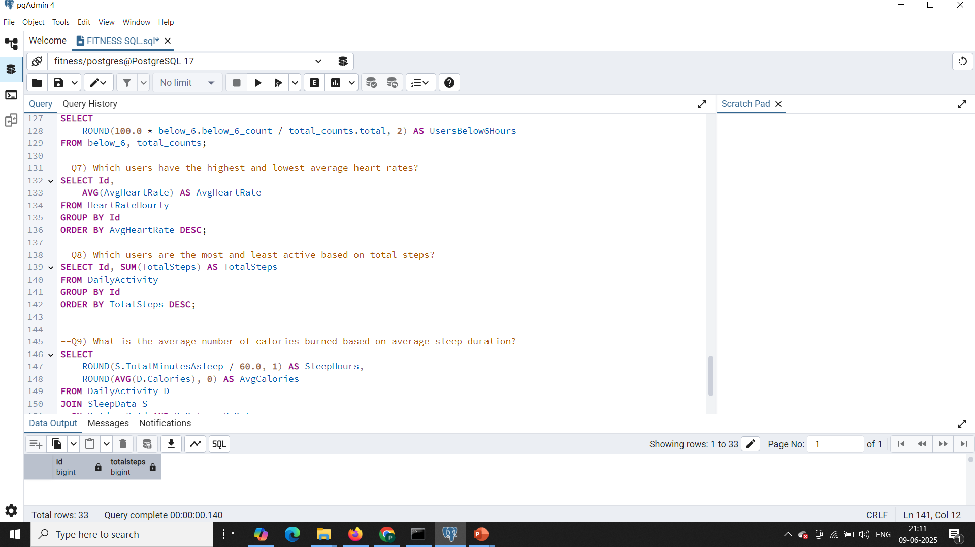
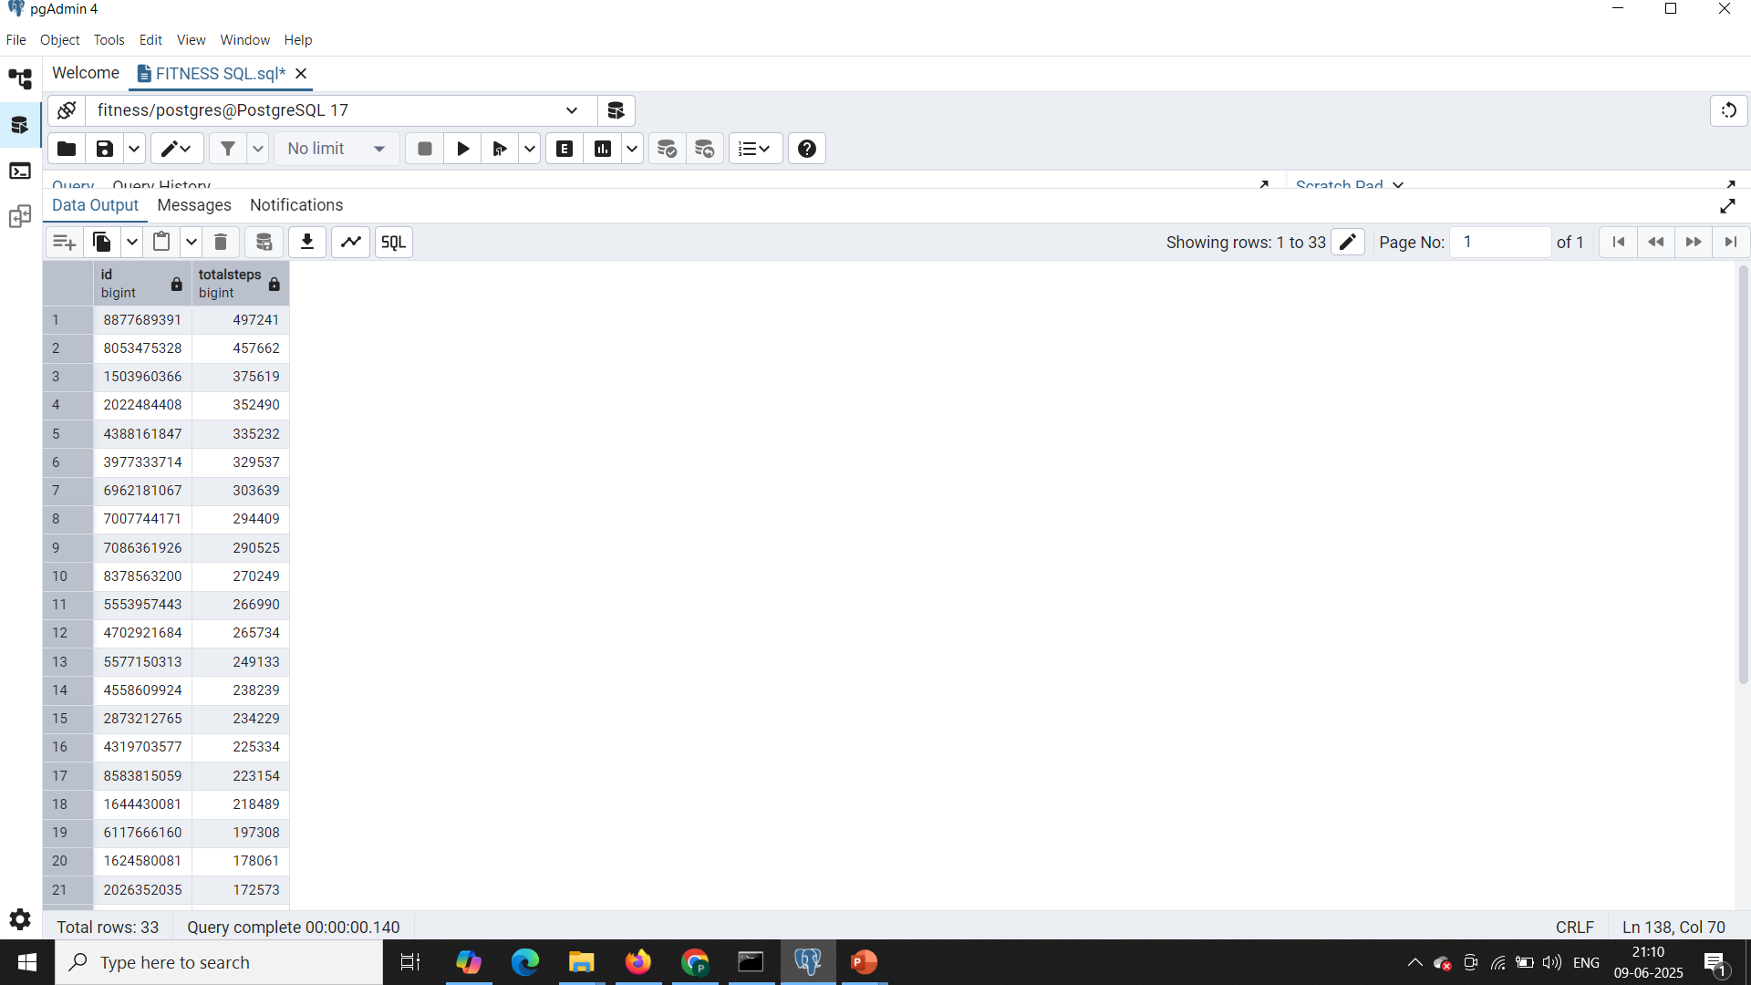
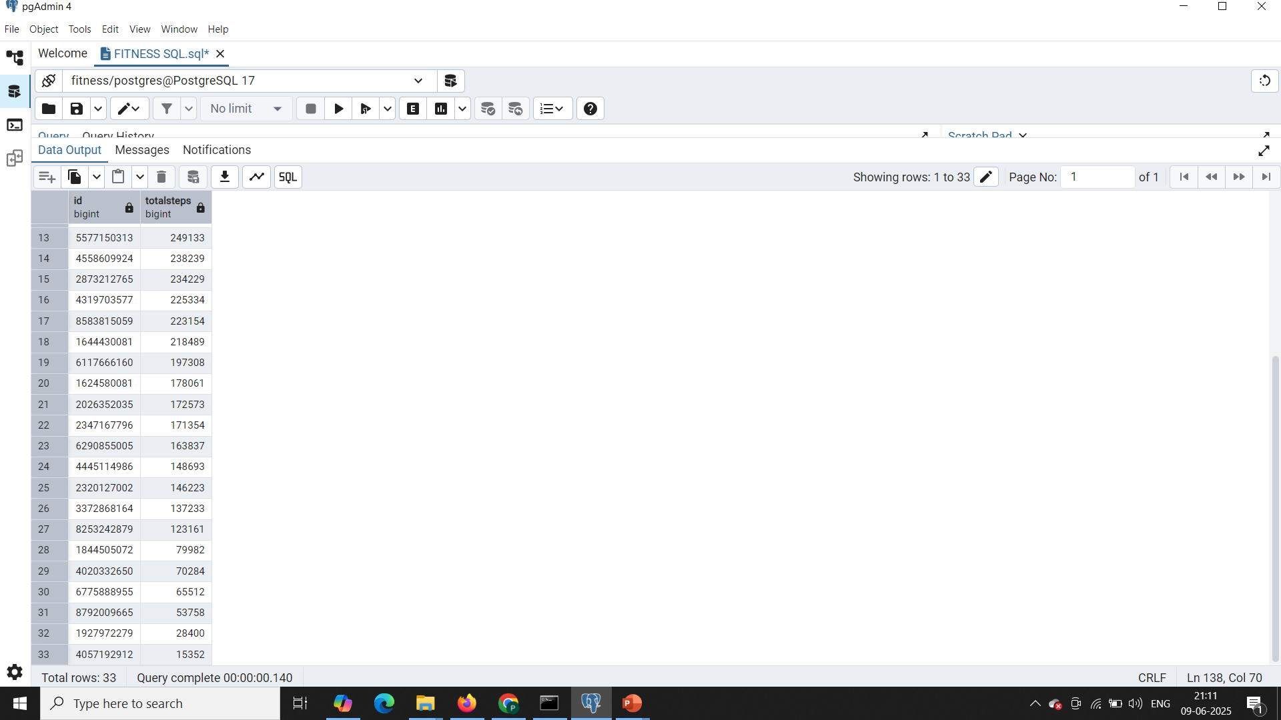
Q8. Which users are the most and least active based on total steps?

Slide 11
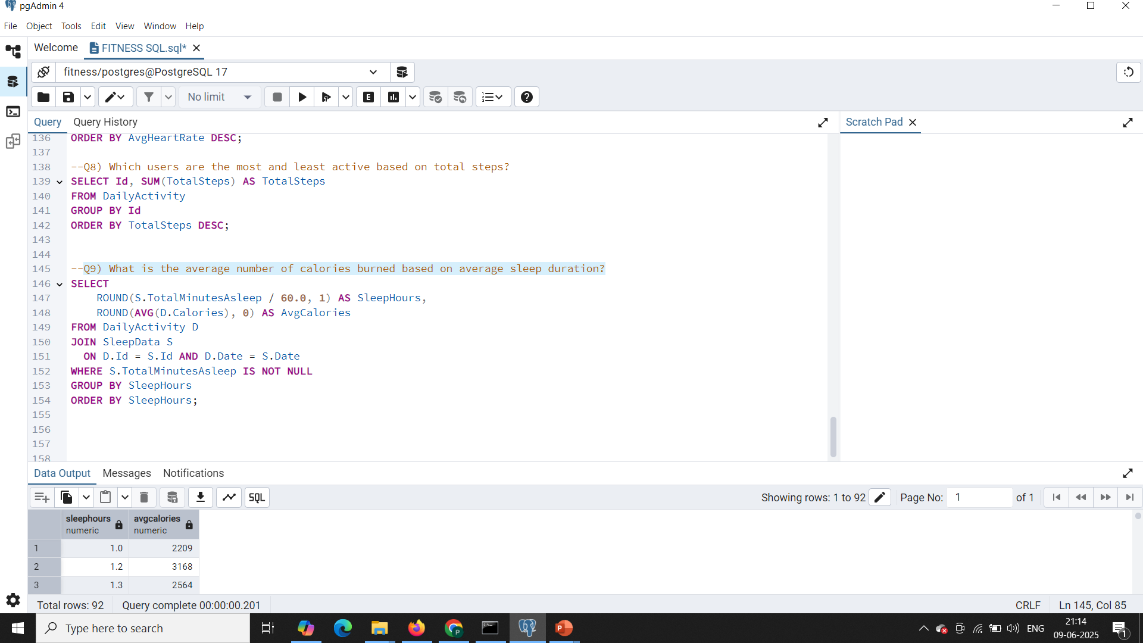
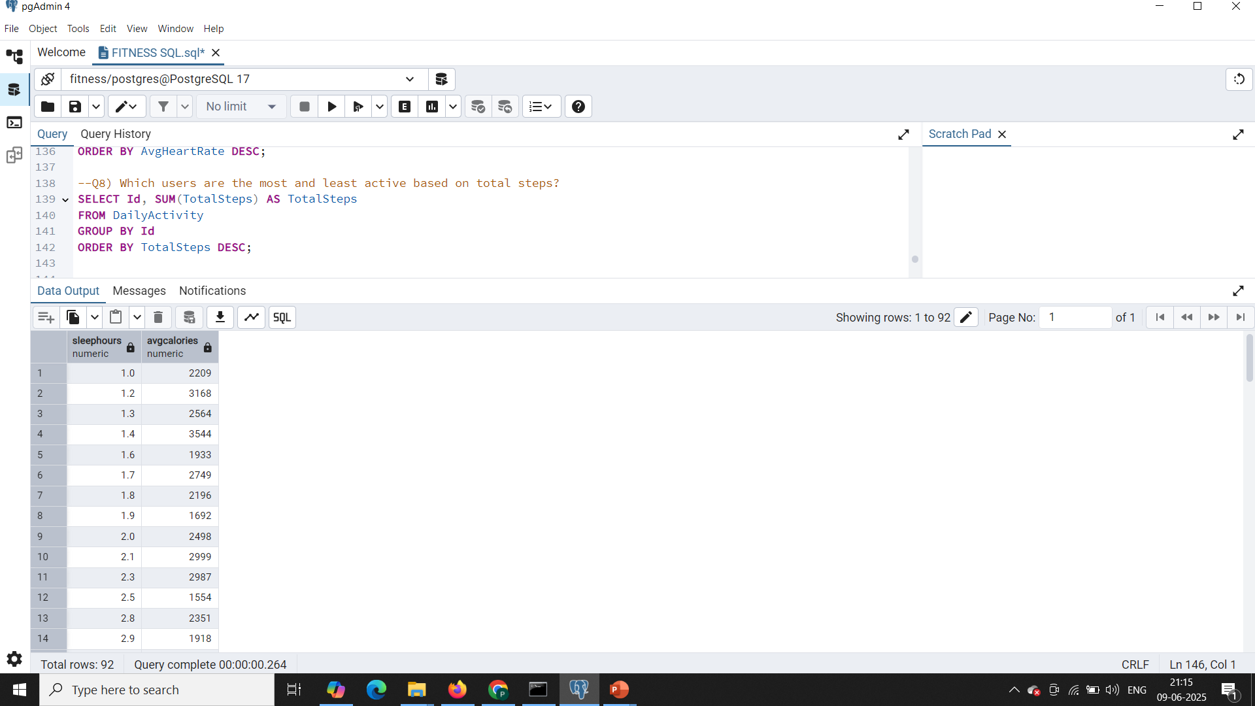
Q9. What is the average number of calories burned based on average sleep duration?

